Slide 1
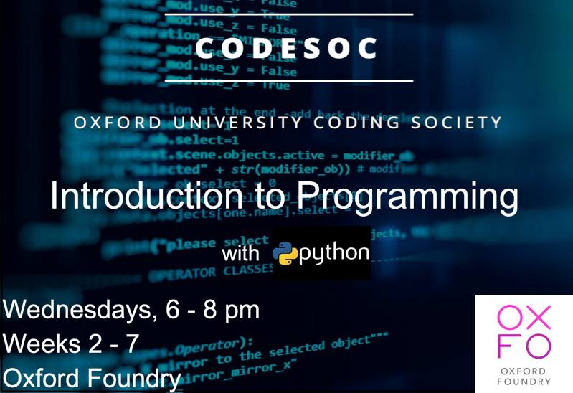
Notes:
Today the topic is a brief introduction to Data Science modules in Python.
We’ll be covering the material a bit differently today. Today we’ll be less interested in exercises and more interested in understanding what different python packages can do for us. I’ll give a brief introduction to data science, a number of python packages, and there will also be tutorials linked below each for you to cover in your own time if they interest you in particular.

Slide 2

Data Science

Slide 3
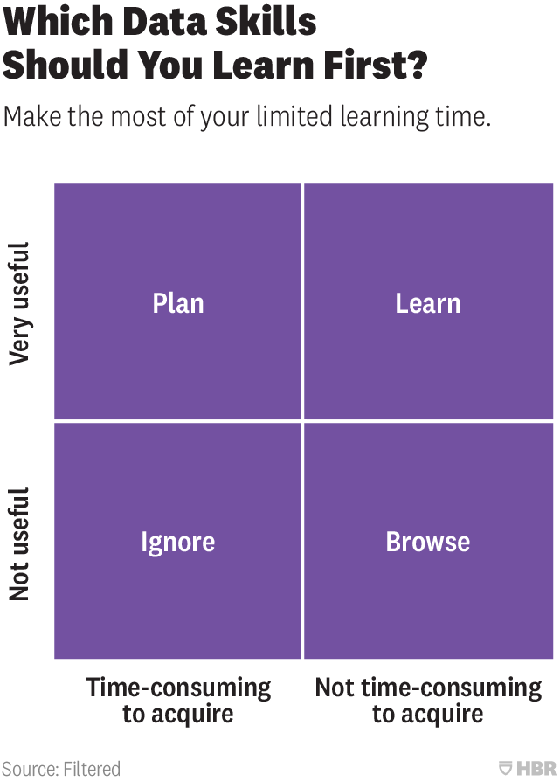
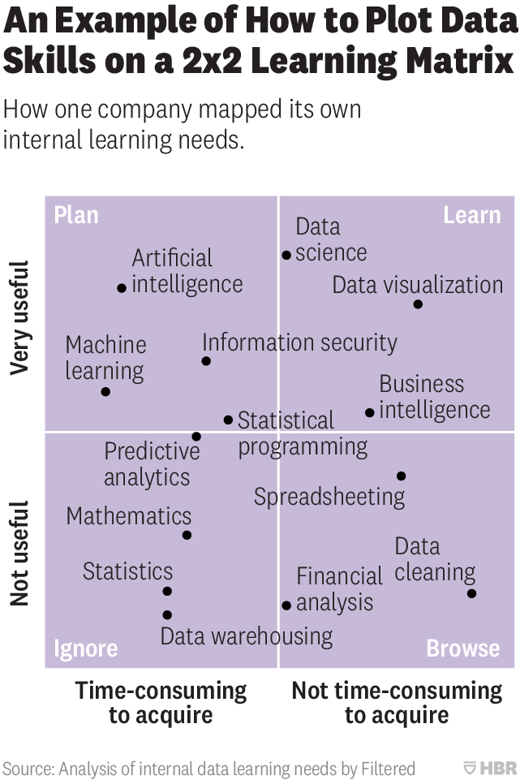

Slide 4

Why are we excited about it?
www.captionbot.ai

Slide 5

https://www.youtube.com/watch?v=D5VN56jQMWM

Slide 6
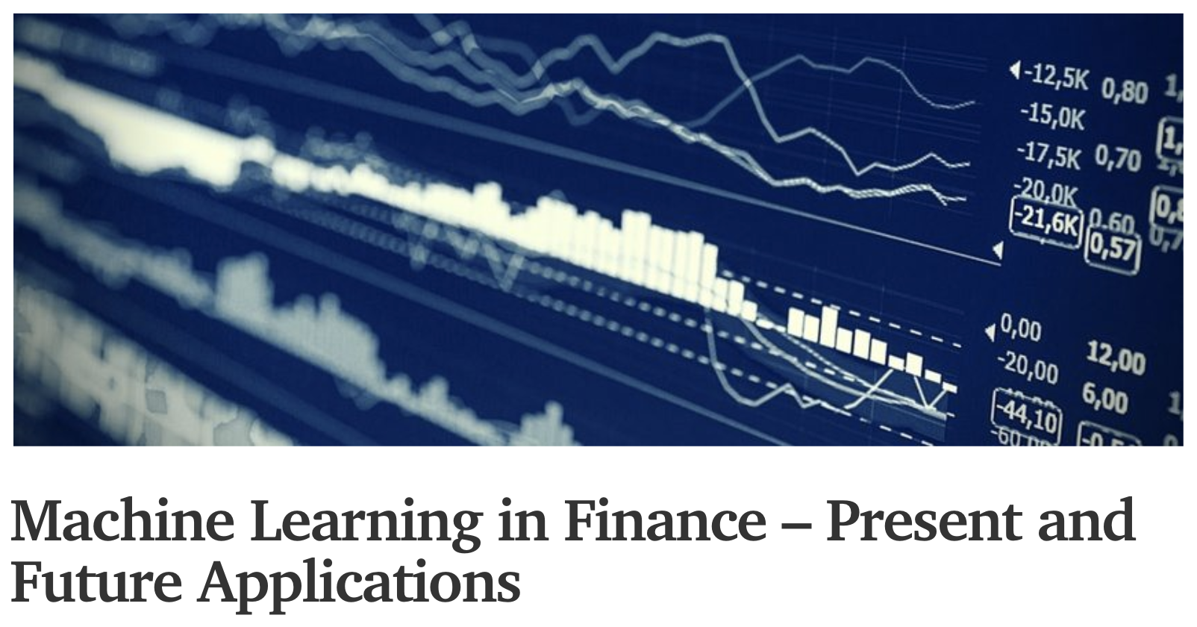

Slide 7
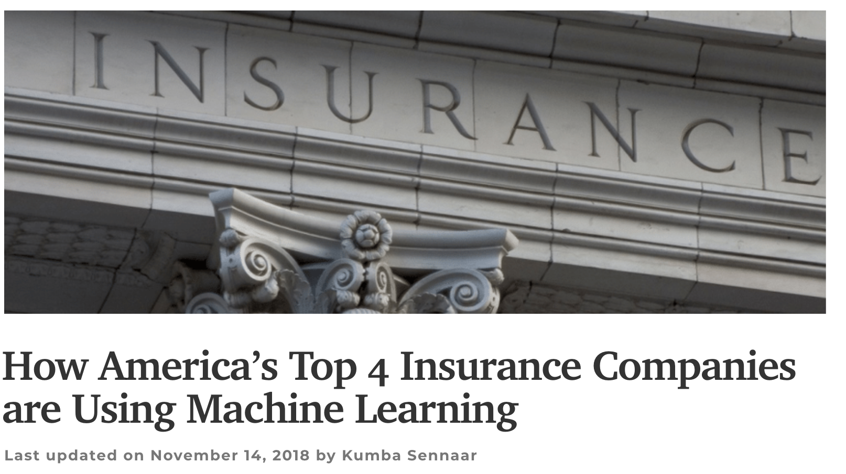

Slide 8
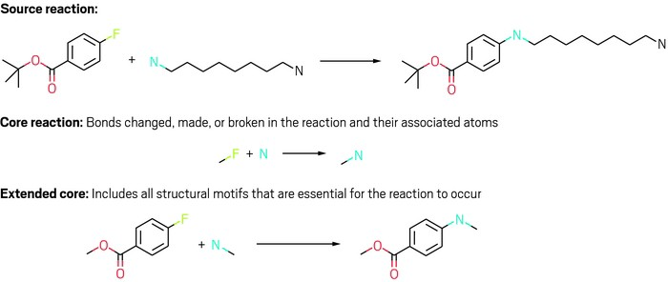

Slide 9
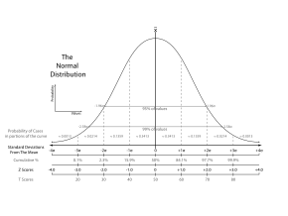
Notes:
And of course, statistics is a great subject area.

Slide 10
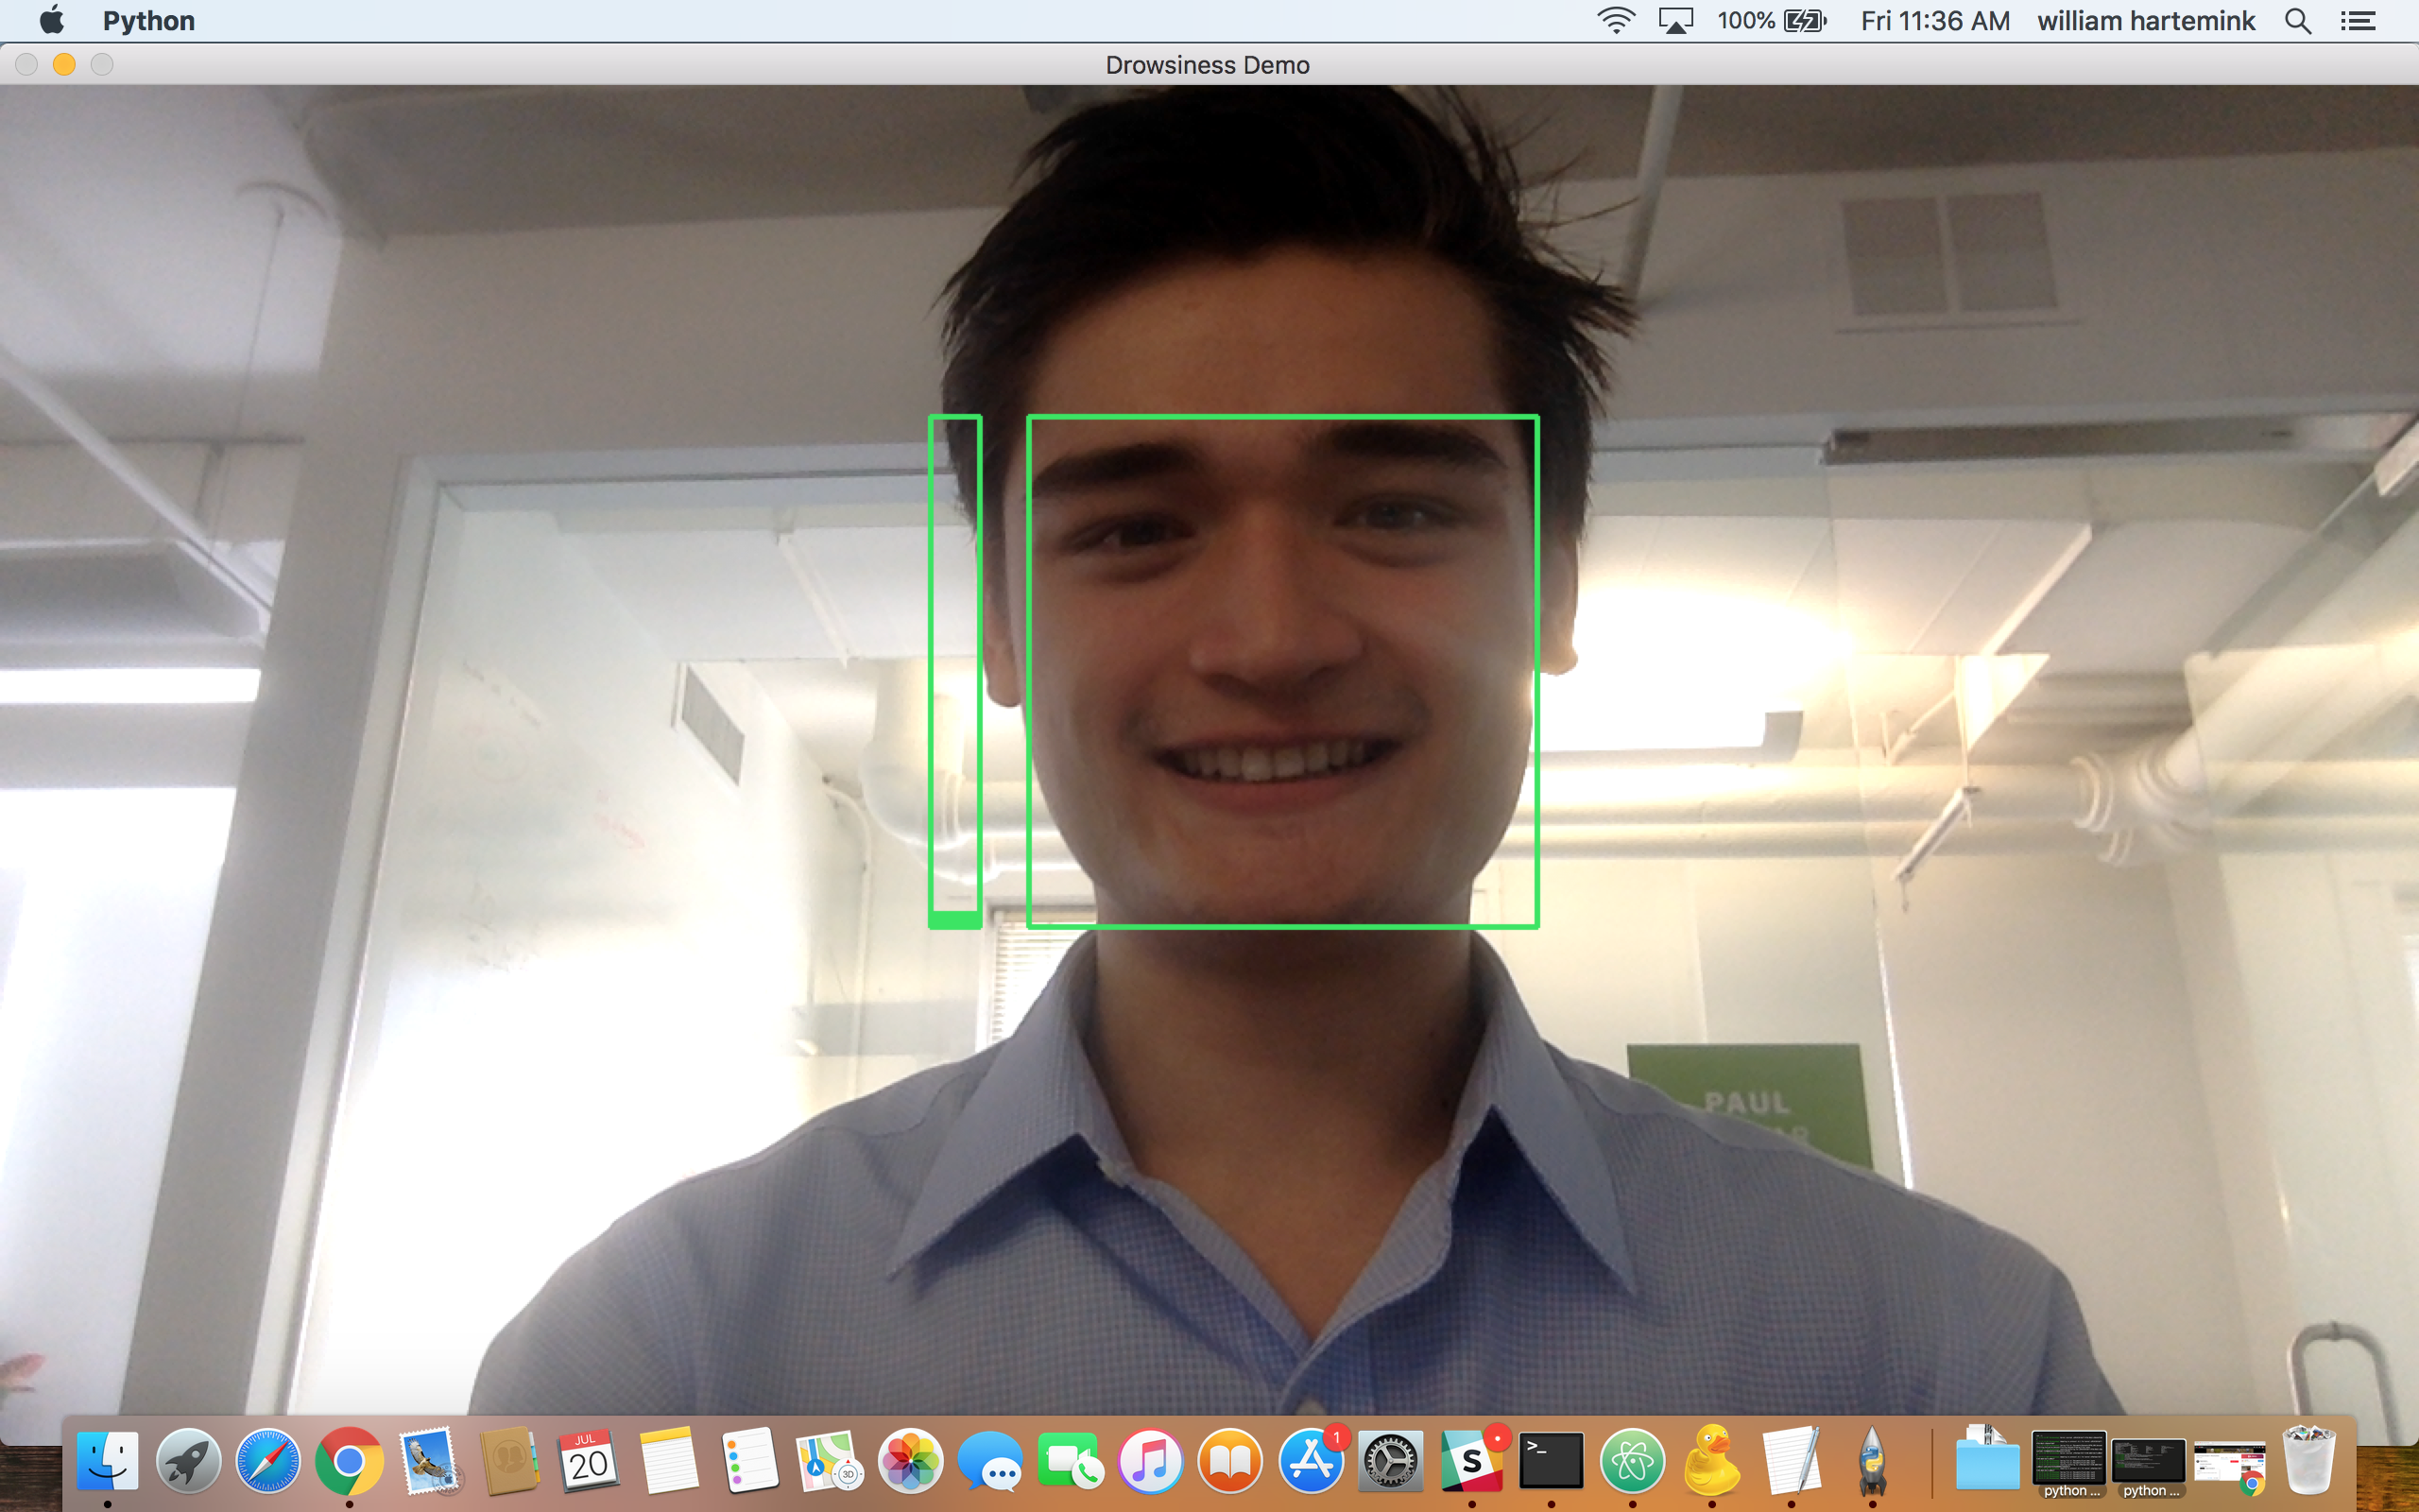
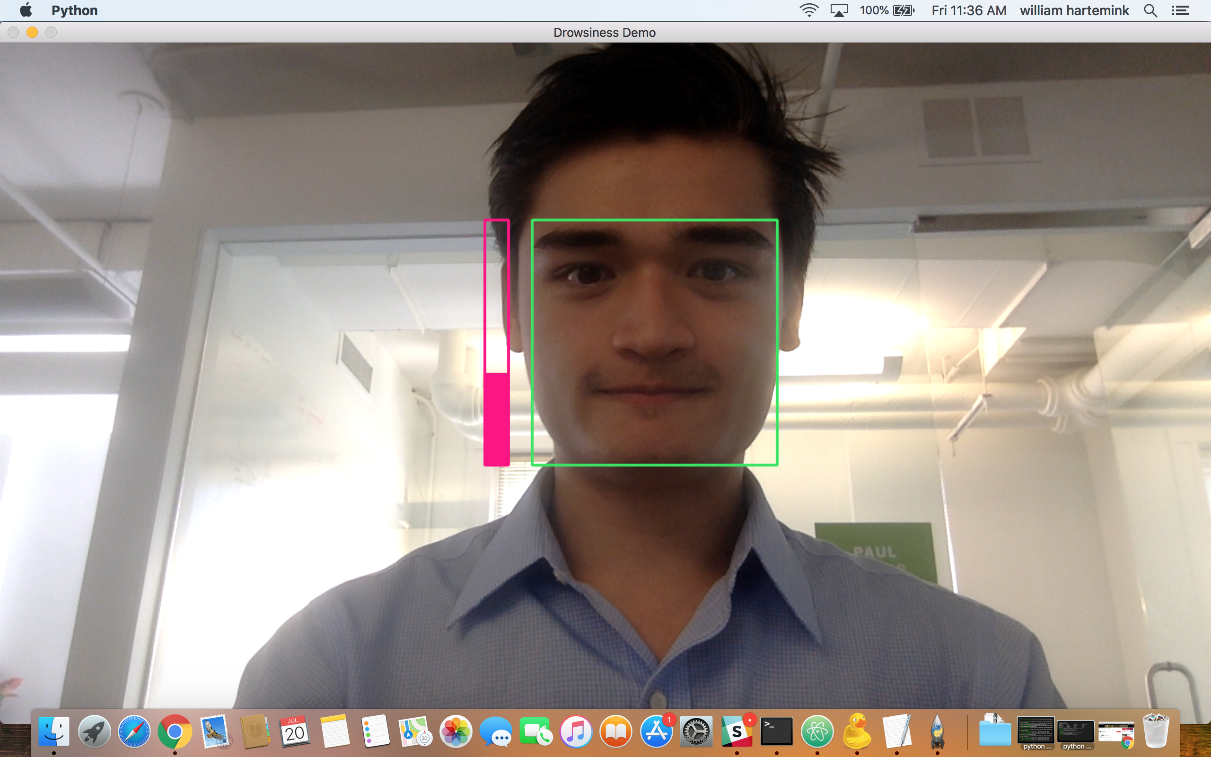
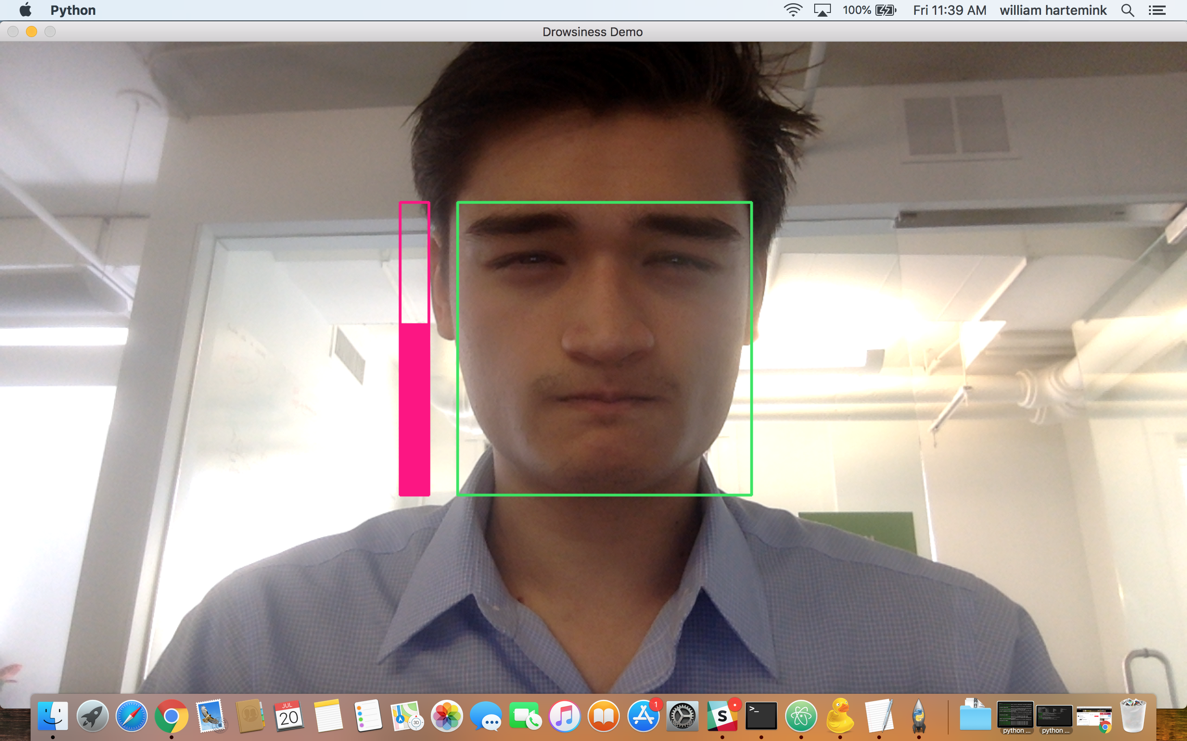
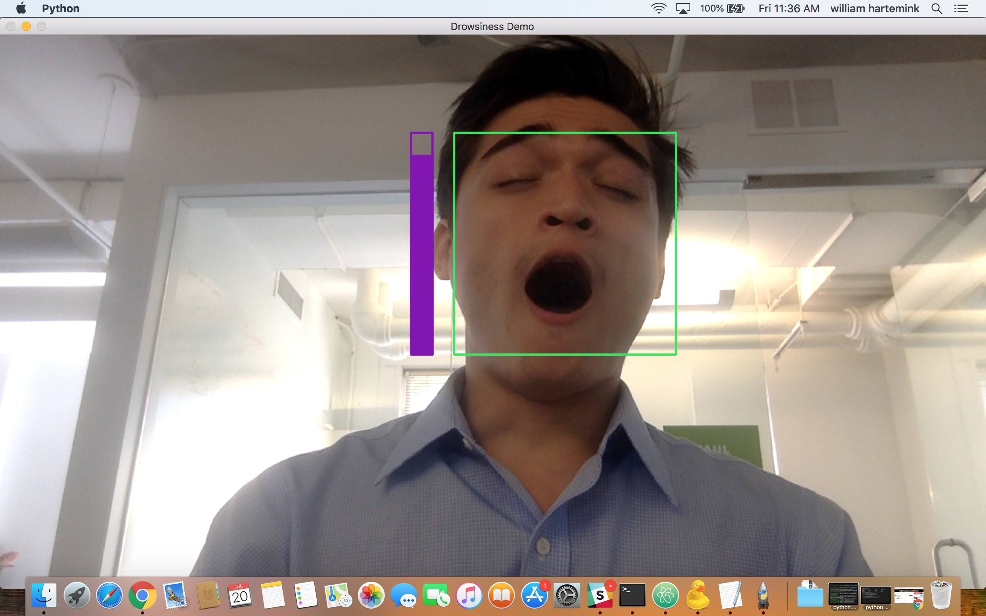
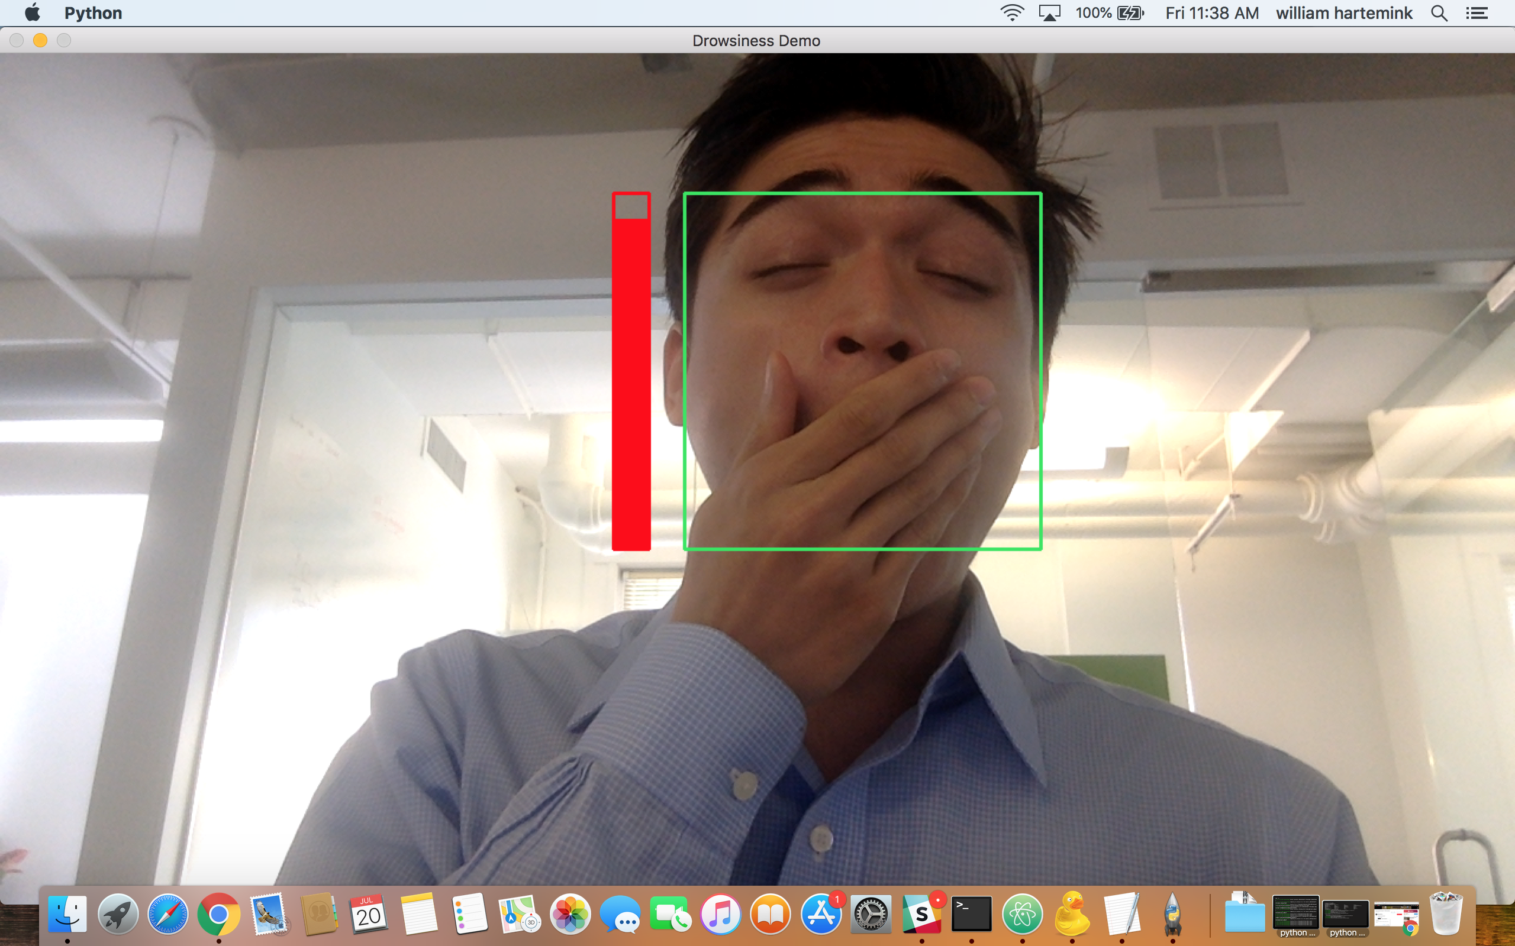

It’s widely available

Slide 11

Notes:
To be clear, we’re not making a living thing here. Machine Learning is indisputably just mathematical modelling.

Slide 12
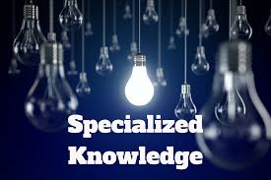
Notes:
As it stands right now, it often requires significant domain knowledge to use data to create state-of-the-art solutions

Slide 13
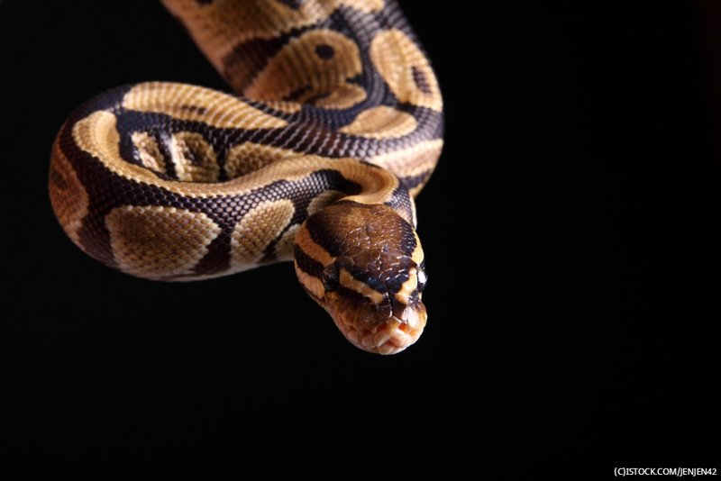
Notes:
So where does Python fit into all of this? A significant portion of the work done in each of the above domains is done in Python

Slide 14
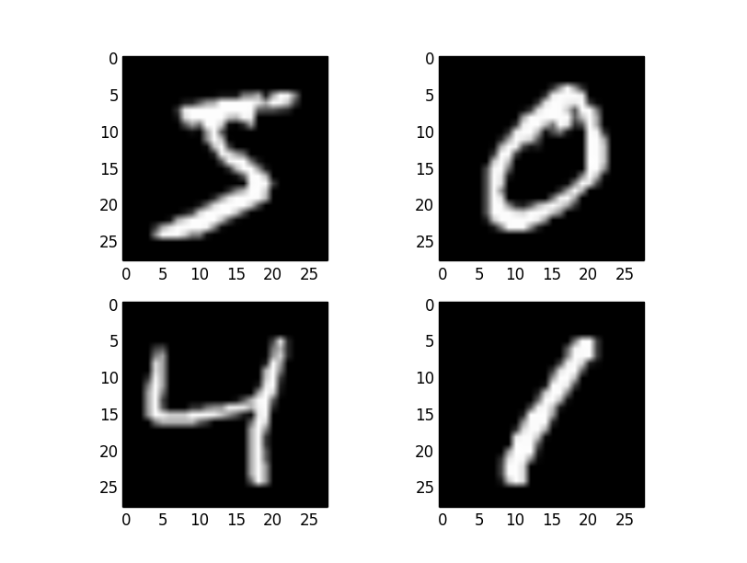
Basics of Machine Learning (Big Picture)
Python Packages
Introduction to Numpy
Pandas
Matplotlib
Sklearn (with Boston House Prices example)
Keras (with MNIST Digit Dataset example)
MNIST Digit Dataset & Neural Networks

Slide 15
What is Machine Learning?
Goal: Use data to draw conclusions or make predictions

Slide 16
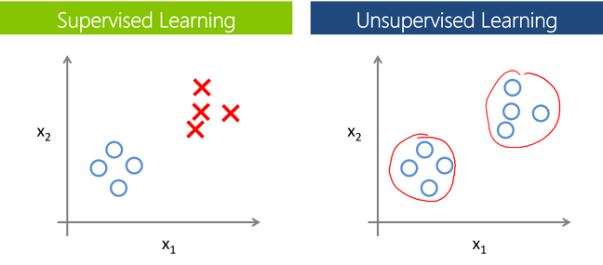
Two types of machine learning
Notes:
There are two types of machine learning: Supervised and unsupervised learning.
Supervised learning comes with labels that we are trying to predict.
Unsupervised learning does not come with labels, and we are interested in understanding the structure of the data. (Primarily Clustering)

Slide 17

Two types of machine learning
Notes:
Today we’re really going to be only worried about supervised learning. It’s where most work is done, and what interests us most. Supervised learning is pretty cool, though, and the two complement each other quite well.

Slide 18
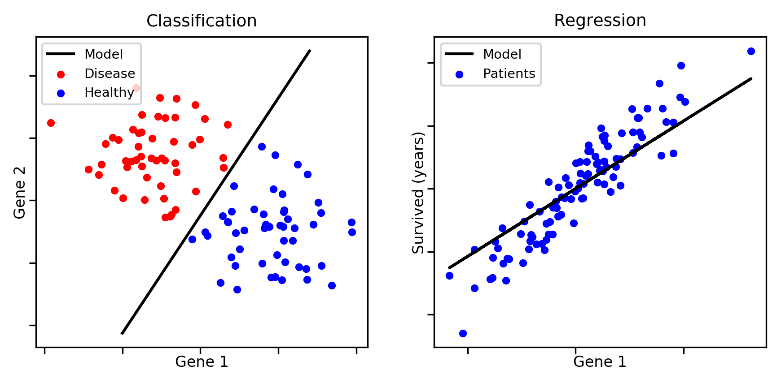
Two types of supervised learning
Notes:
And again we can split supervised learning into two subcategories.

Slide 19
Notes:
So we have some data, and then some label our outcome that we’re trying to predict.
In this case, our input data are the pixels in the images, and the numbers that the images represent are the labels

Slide 20
X
y
Notes:
We can think of this sorta mathematically. We use X to predict y. So in this case, X is 28 x 28 for each image, because there are 28 x 28 pixels.
We use each pixel to predict y, and so each pixel, we call a predictor variable, or just predictor. So we have 784 predictor variables
Y is just a single value, a number from 0 to 9.

Slide 21
X
y
Notes:
And we can view the task of modelling inputs to outputs as function-finding. We want to find some function that maps from our Xs to ys.

Slide 22
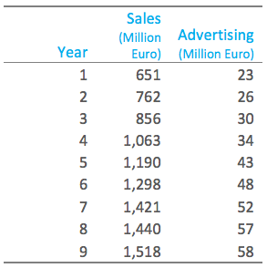
Notes:
So, what can we do? Well for some data, we can use linear regression. Say we’re trying to predict sales, and we are trying to use advertising to predict sales. How many predictors do we have?
Here we can see what the relationship between sales and advertising is using linear regression

Slide 23
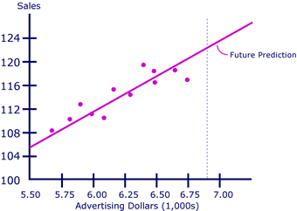
Notes:
In this case, it seems linear regression makes a lot of sense.

Slide 24
Notes:
But if we return to the case of digit classification, linear regression doesn’t make a whole lot of sense. After all, our task is to Classify, not regress.

Slide 25
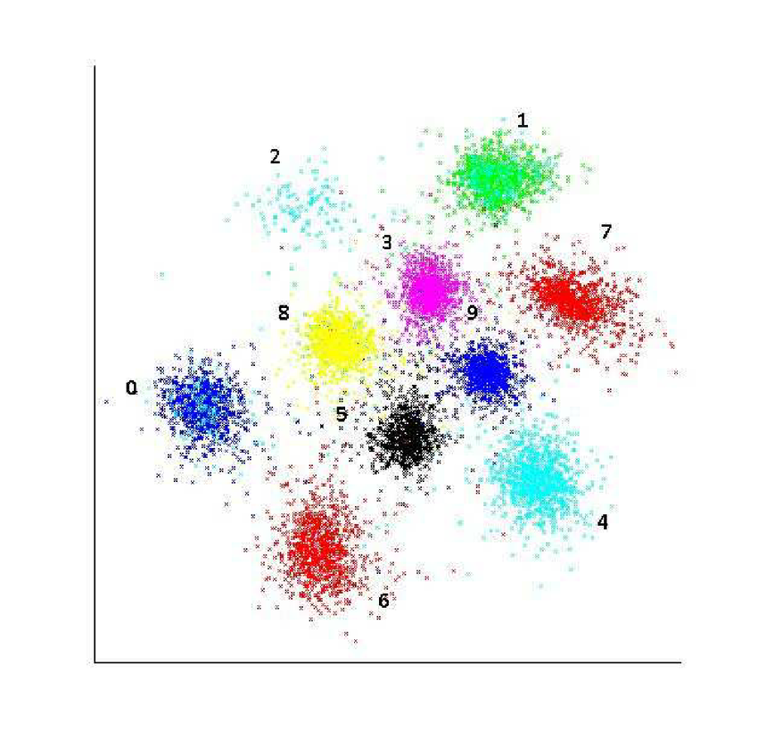
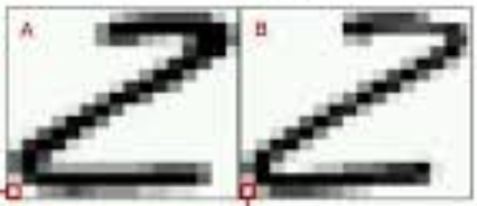
Notes:
Each pixel in a given image has a number associated with it, and there are 784 pixels. We might guess that the number two has white pixels and black pixels in toughly the same places.
And so if we plotted the digits in a 784-dimensional space -- one dimension for each pixel – images of 2s might cluster together, and 3s, and 4s and so on….

Slide 26
.
Notes:
So say if we wanted to classify a new digit, we might try to see what’s closest to that point.
And this is of course just a 2D representation of our 784 dimensional space. How did we get here? Unsupervised learning, but that’s for another day

Slide 27
Notes:
And how do we know how good our model is? We’ll we could look at the accuracy of our model on the training data …
But of course, if we tested our model on the training data it would be correct 100% of the time. The closest point to any of these digits is itself, which the model was trained on.

Slide 28
Notes:
So do we have a perfect model? Not exactly. Of course, we don’t care about classifying digits we have already labelled for our machine learning model. We want to be able to recognize new digits.

Slide 29
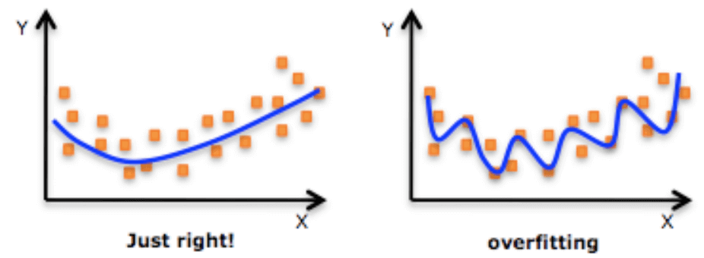
Notes:
In the case of 1-predictor regression, our dilemma might look like this

Slide 30
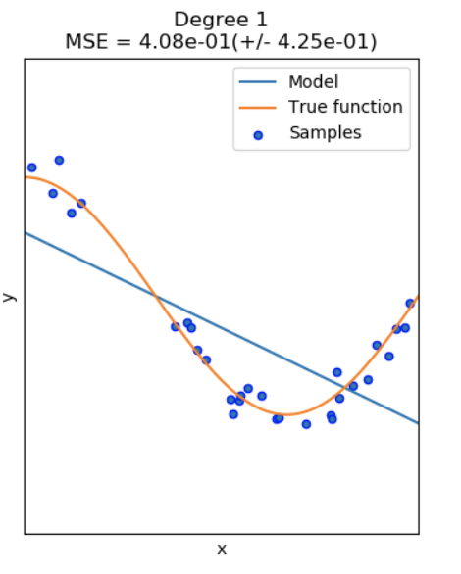
Notes:
In other words, we want to pick up on fundamental patterns about what makes a 5 a 5, rather than just memorize each picture we see.
Of course we can also imagine the opposite problem. We construct a model that doesn’t learn enough.
We call this the overfitting-underfitting problem, or the bias-variance tradeoff.

Slide 31
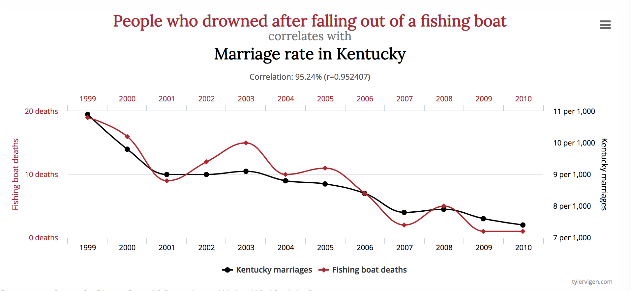
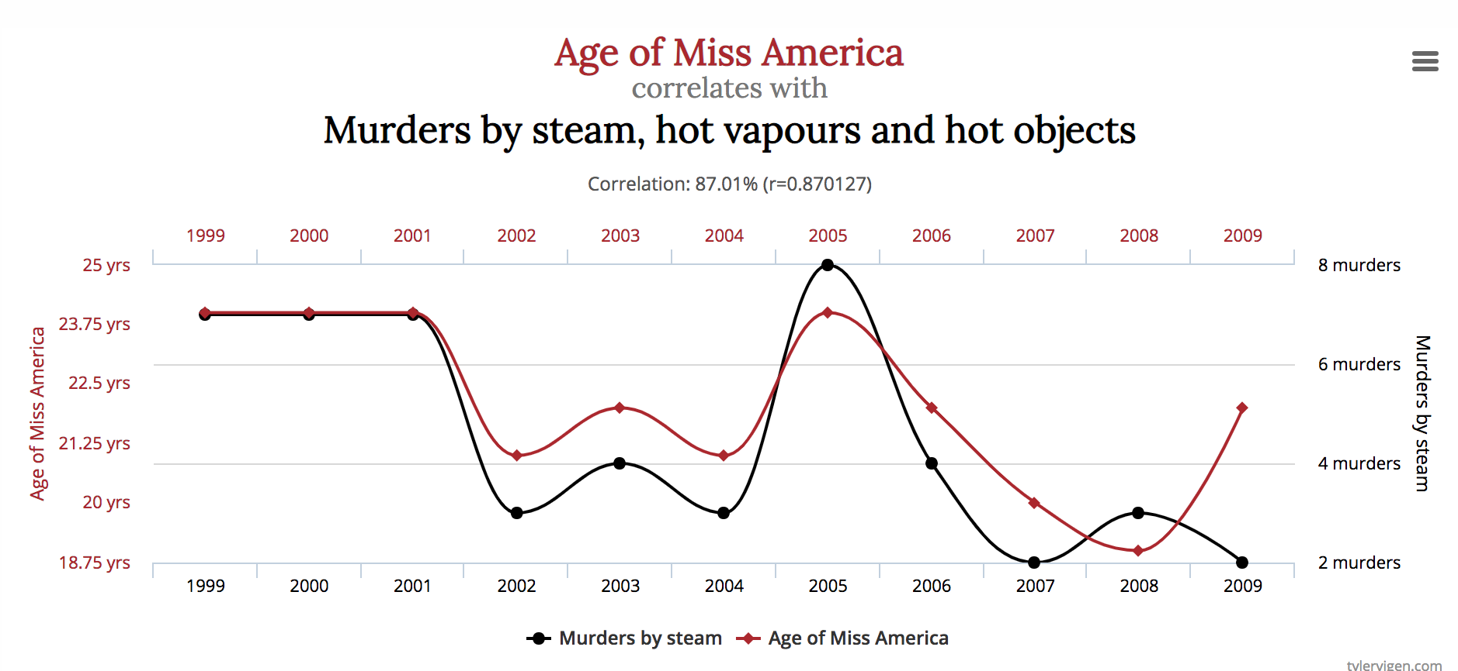
Notes:
There are many techniques for dealing with this. Some of this requires domain knowledge. For instance, you only want to include data that is relevant to the task at hand

Slide 32
Notes:
There are many techniques for dealing with this. Some of this requires domain knowledge. For instance, you only want to include data that is relevant to the task at hand

Slide 33
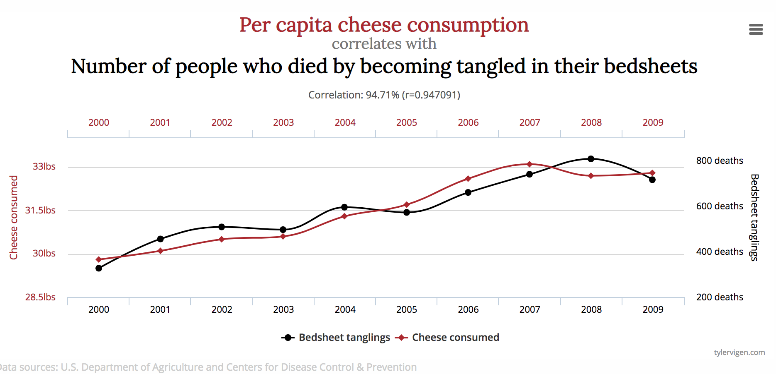
Notes:
There are many techniques for dealing with this. Some of this requires domain knowledge. For instance, you only want to include data that is relevant to the task at hand

Slide 34
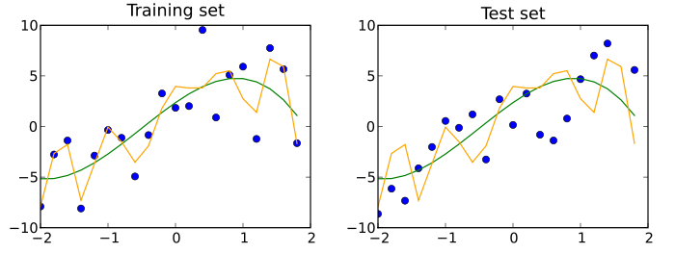
Notes:
One thing we can do to prevent this is to create a test set. We can partition our dataset so that the model – after fitting our training data – can be tested on data it’s never seen before, and so we have some final assessment of how good the model is.

Slide 35
Notes:
What if, like in this case, the model isn’t very good? Well, we could go back to the training set and start all over again, but we don’t want to do this. As soon as we make changes to the model from knowledge that we have about the test set, the test set no longer assesses how good our model is. Does that make sense?

Slide 36
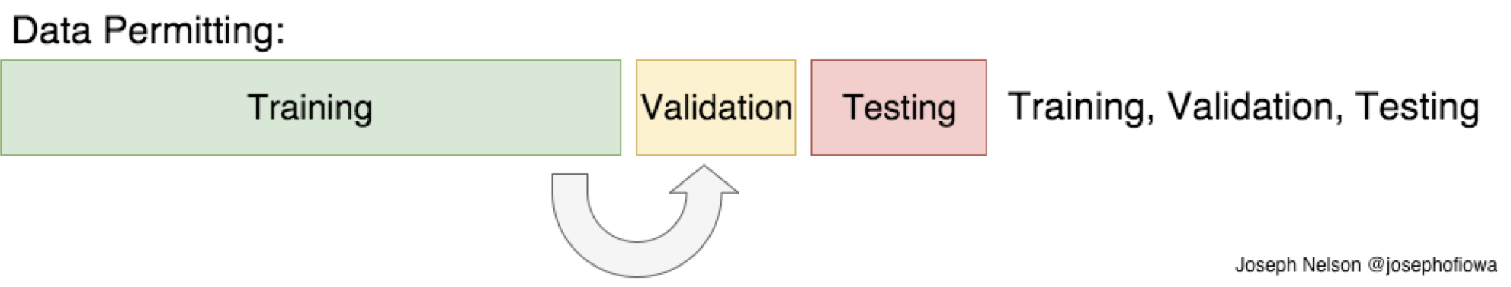
Notes:
So what we can do instead is group our data into training / validation / test sets. So at first we can go back and forth between our training and validation set, and make decisions on what kind of a model to use. Then when we feel confident enough about our model we can give it a final assessment in the training set.

Slide 37
Basics of Machine Learning (Big Picture)
Python Packages
Introduction to Numpy
Pandas
Matplotlib
Sklearn (with Boston House Prices example)
Keras (with MNIST Digit Dataset example)
MNIST Digit Dataset & Neural Networks

Slide 38
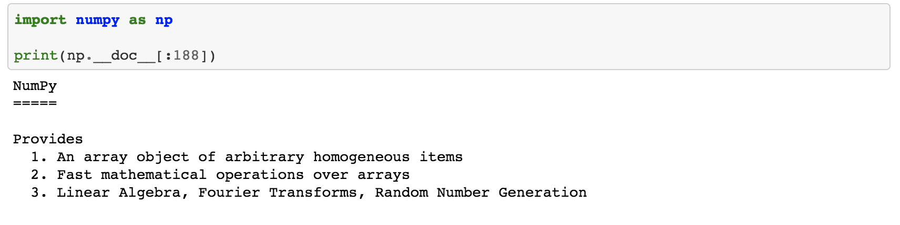

Slide 39
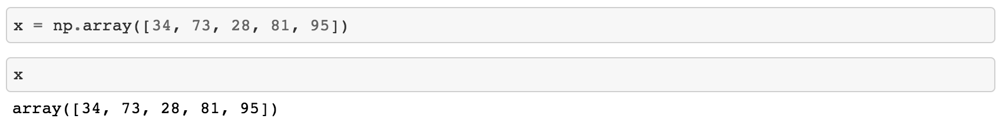

Slide 40
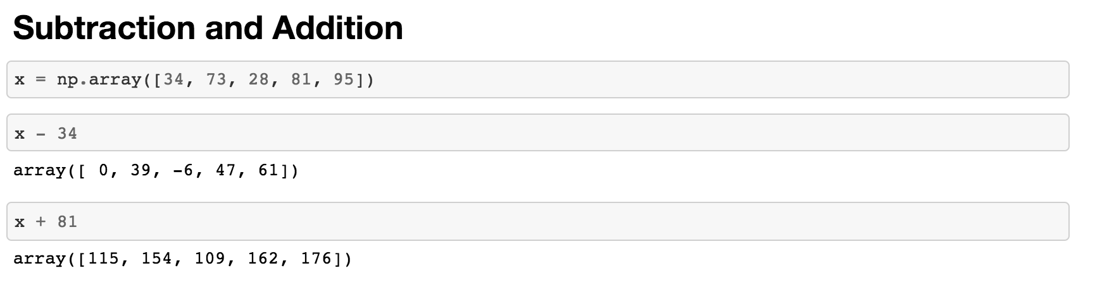

Slide 41
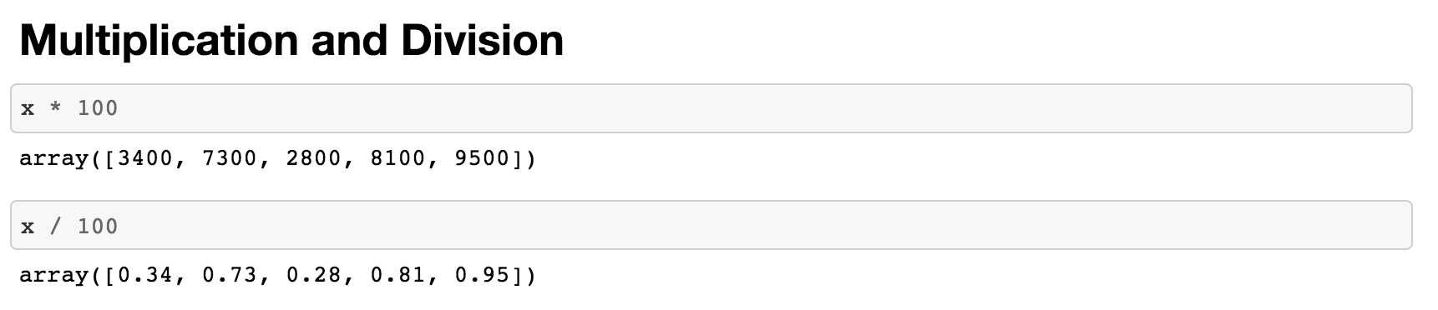

Slide 42
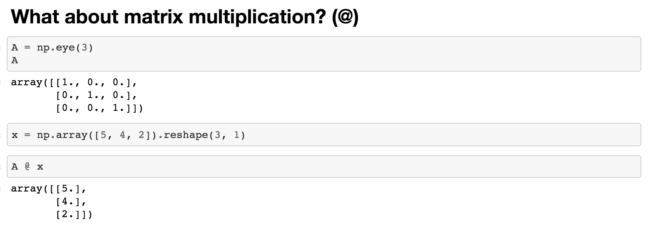

Slide 43
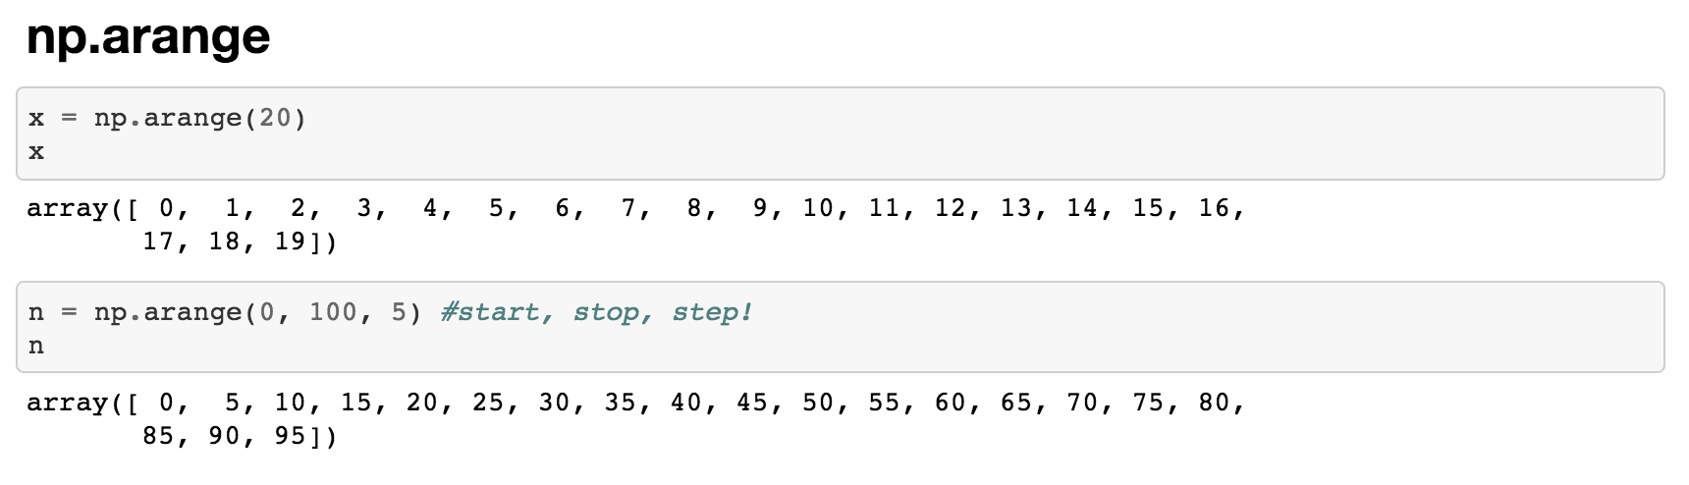

Slide 44
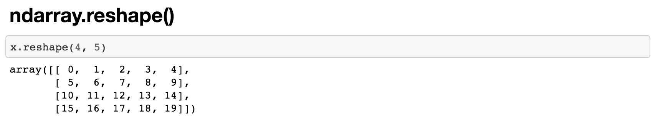

Slide 45
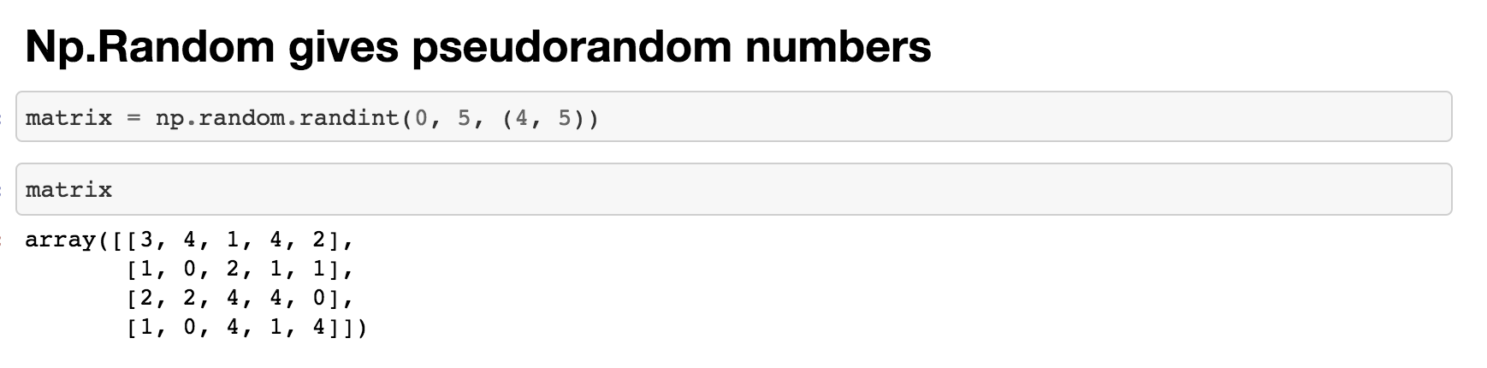

Slide 46
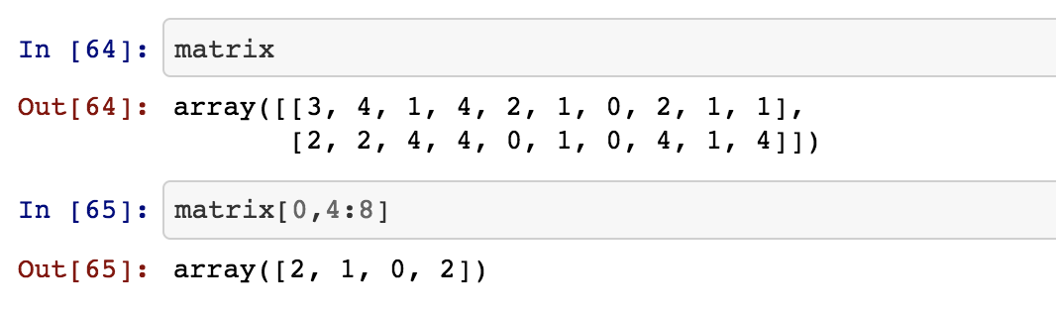

Slide 47
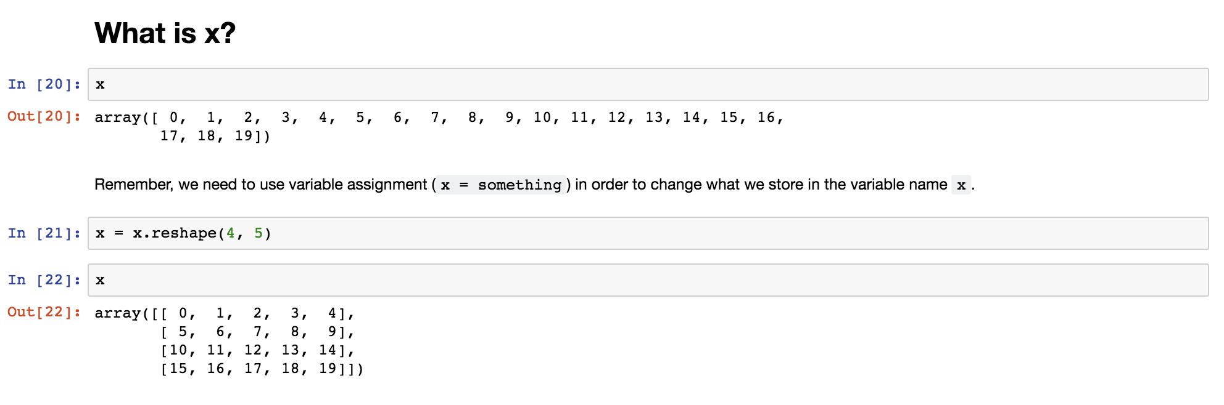

Slide 48
Basics of Machine Learning (Big Picture)
Python Packages
Introduction to Numpy
Pandas
Matplotlib
Sklearn (with Boston House Prices example)
Keras (with MNIST Digit Dataset example)
MNIST Digit Dataset & Neural Networks
Notes:
So I’ve put together some ipython notebooks with basic explainers for how each of the packages work. I’d recommend going through them in the given order. There aren’t exactly exercises with these because the task at hand is quite difficult, but the latter two walk us through some real modelling examples.
Each of them come with links to tutorials, and if you’re interested, I would try them out right now! It’s nice to get comfortable with online tutorials in areas that you’re interested in.
And if we’re interested in the end, we can pivot to watching a video on deep neural networks and how they work.

Slide 49
What tutorials next week?
Build a tweetbot in Python
Mass email sending
Controlling your mouse / keyboard in Python
Running scripts in the background of your computer (MacOS)
More tutorials you might be interested in? Let me know!
Notes:
So next week we will break up into groups and try to build some more challenging programs than we’ve tackled so far with the help of some tutorials

